Slide 1
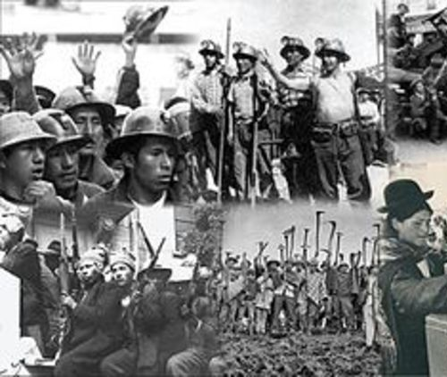
La Matanza and Erasure
Carlos Lozoya

Slide 2
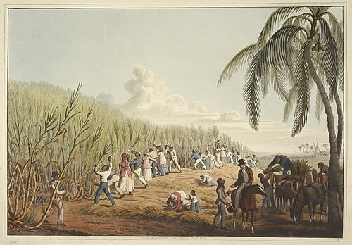
Timeline
Colonial Rule: Fifteenth Century
Spanish Colonizers, after killing a large population from smallpox, exploited indigenous people for agricultural use, mostly coffee production. Lasted until 1821
Post Rule: 1821-1900’s
Coffee remained a major part of economy. Laws for agriculture forced indigenous people off their land (approximately ¼ of arable land in El Salvador privatized by the government)
Notes:
Wiped out indigenous land

Slide 3
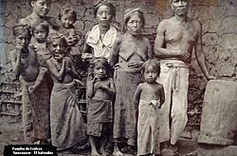
Demise of Indian ethnicity
La Matanza
Recounted as a communist Party mostly composed of indigenous people, uprose in response to government control.
In response the government, led by dictator General Martinez, targeted indigenous people and outlawed indigenous language and dress.
indigenous people abandoned their identity in order to survive.
Lost and unknown to the archive, Government stops looking for Indigenous history.

Slide 4

https://clozoy01.github.io/remix_past/

